Slide 1

Web technologies using java
Course 11 – Unit testing with junit5 and mockito

Slide 2
agenda
Software testing
Unit testing
Mocking dependencies

Slide 3
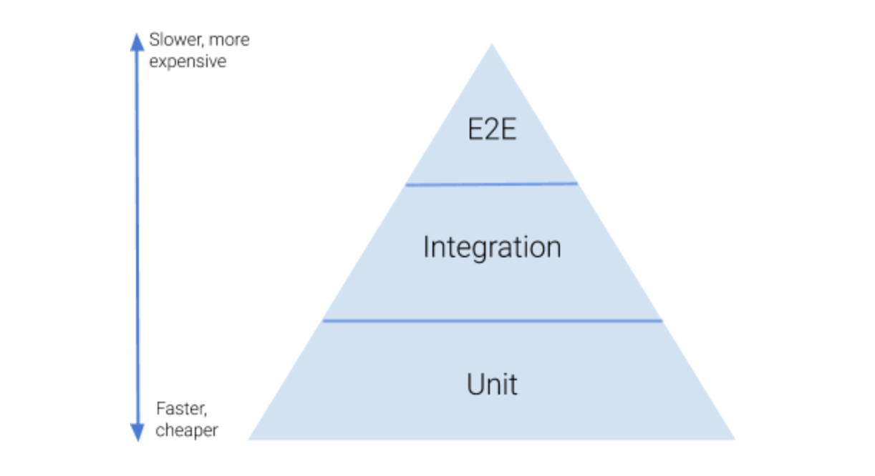
Software testing
Functional testing:
Unit tests: tests that cover one single method
Integration tests: tests that cover the system
End-to-end tests: tests that cover the system in integration with other systems
Non-functional testing:
Performance testing
Security testing

Slide 4
Unit testing
Benefits of unit tests:
allow greater test coverage than end-to-end tests
increase team productivity
detect regressions and limit the need for debugging
give us the confidence to refactor and, in general, to make changes
improve implementation
document expected behavior
enable code coverage and other metrics

Slide 5
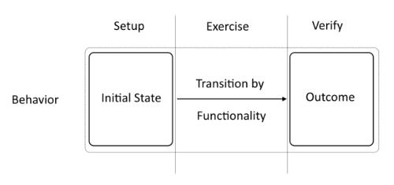
Unit testing
Structure of a unit test:
setup (arrange, build): this state constitutes well-defined test input and precondition; it is also called the fixture of a test
exercise (act, operate): this state is used to invoke the functionality the test intends to check
verify (assert, check): this state verifies that the outcome actually matches the specified behavior
teardown: this state makes sure the test leaves its environment in the same condition as it was in before the execution of the test.

Slide 6
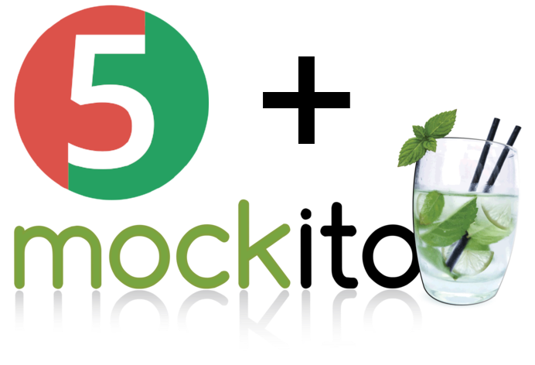
Mocking dependencies
mock frameworks:
aim to ease stand-in component creation and configuration
make it easier to replace third-party components, which otherwise might be expensive to create
fluent interface API style
configuration is done prior to the exercise phase by means of the tool API. This allows us to stub return values and verify indirect outputs and interactions easily
allow for verification of dependent method calls
well-known mock frameworks: Mockito, PowerMock, EasyMock

Slide 7
bibliography
Java Unit Testing with Junit 5, by Shekhar Gulati, RahulSharma
Pragmatic Unit testing in Java 8 with Junit, by Jeff Langr

Slide 8

Q&A

Slide 9
THANK YOU
DANIELA CIUPERCA

